Slide 1

Book Recommendation System By: Valli, Gandhimati, Vathan, Sharath

Slide 2
CONTENTS
Introduction
Project Overview
Exploratory Data Analysis (EDA)
Data Preprocessing
Modeling
Streamlit Demo
Book Recommendation Chatbot Demo

Slide 3

Introduction
Introduction:
A system that recommends books using advanced Natural Language Processing (NLP) models and integrates a chatbot for interactive user experience.
Problem Statement:
Overwhelming number of books makes it difficult for readers to find relevant titles.
Lack of personalized recommendations and efficient systems to cater to user preferences makes it even more exhausting.
Solution:
An interactive chatbot that allows users to query and refine results based on specific interests.
Leveraging NLP models like BERT, TF-IDF, and hybrid approaches to provide personalized book suggestions.
An interactive chatbot that allows users to query and refine results based on specific interests.

Slide 4
Project Overview
Data Collection and Exploration:
Collected book datasets including titles, authors, descriptions, categories, and ratings.
Explored data to understand distribution, missing values, and patterns.
Data Preprocessing:
Handled missing values and normalized text descriptions.
Applied NLP techniques for spelling corrections and query expansion.
Feature Engineering:
Generated embeddings using models like TF-IDF, BERT, and Word2Vec.
Engineered graph-based relationships between authors and books.
Model Selection:
Implemented multiple recommendation models:
TF-IDF for keyword matching.
BERT, RoBERTa, DistilBERT for contextual recommendations.
Hybrid approach to aggregate results from all models.
Deployment:
Integrated Flask API to enable user interaction.
Deployed a chatbot interface for querying recommendations in real-time.

Slide 5
Dataset Overview
The dataset contains information about books, including columns such as title, author, description, rating, and publication_year.
There are 6810 rows and 12 columns in total Key Columns: title: Name of the book. authors: List of authors.
categories: Book genres or topics.
average_rating: Average user rating on a scale of 0 to 5.
ratings_count: Number of user ratings for the book.
published_year: Year the book was published.
isbn10: 10-digit International Standard Book Number.
isbn13: 13-digit International Standard Book Number.
thumbnail: URL of the book's cover image.
description: Brief summary or description of the book.
subtitle: Additional title information (e.g., a tagline).

Slide 6
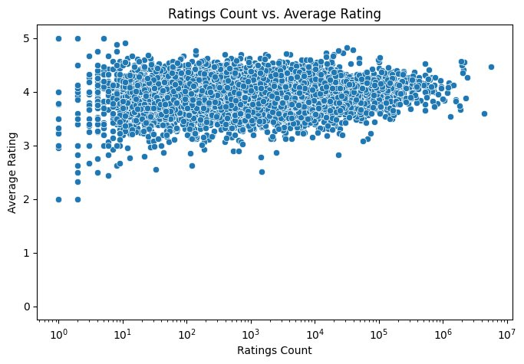
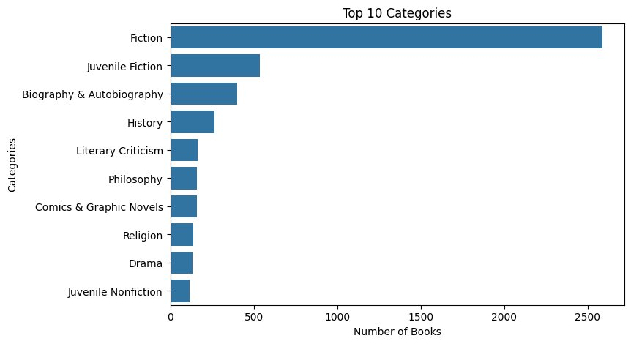
Exploratory Data Analysis (EDA) .

Slide 7
Descriptive Statistics
75%
19%
50%
75% of the books are rated 3.77 or higher, showing generally positive feedback.
19% of the books have missing descriptions, indicating the need for careful handling of missing data.
50% of the books have 304 pages or fewer, indicating they are medium-length on average.

Slide 8

Data Processing

Slide 9
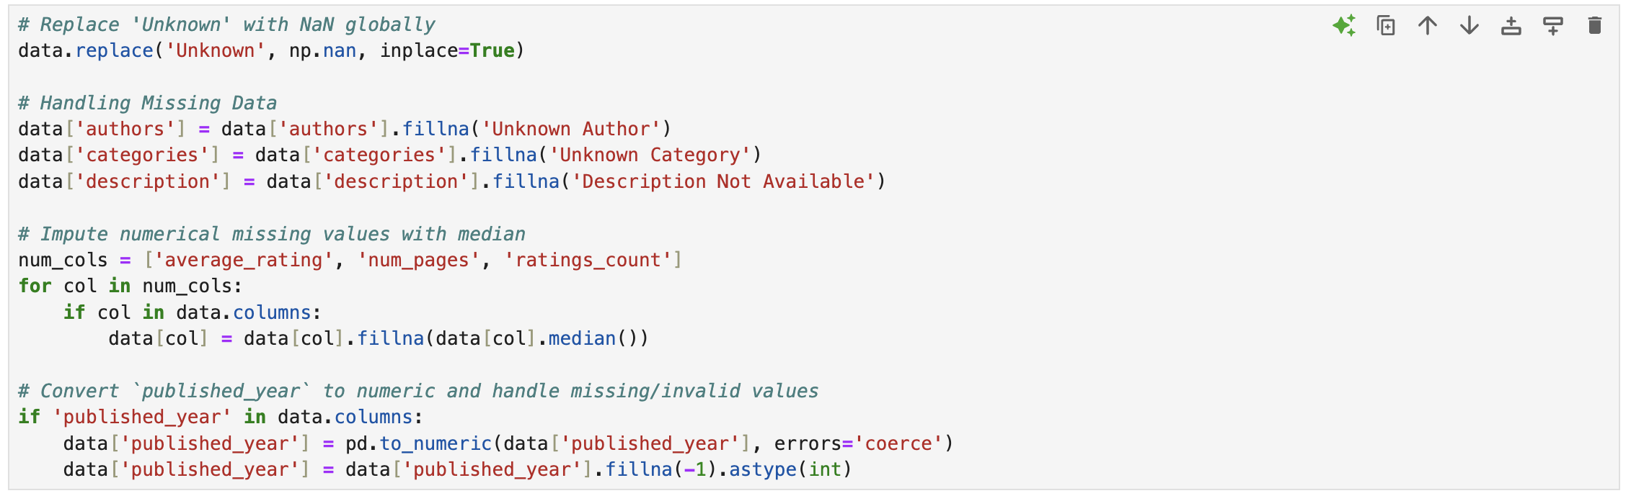

Data Standardization and Cleaning
Replaced Missing and Unknown Data
Replaced occurrences of 'Unknown' globally with NaN for consistent missing value handling.
Filled text column gaps with placeholders
authors: 'Unknown Author'
categories: 'Unknown Category'
description: 'Description Not Available'
Converted published_year to numeric and replaced missing/invalid values with -1. Removed Unnecessary Columns
Dropped irrelevant fields: subtitle, thumbnail, isbn10, isbn13.

Slide 10
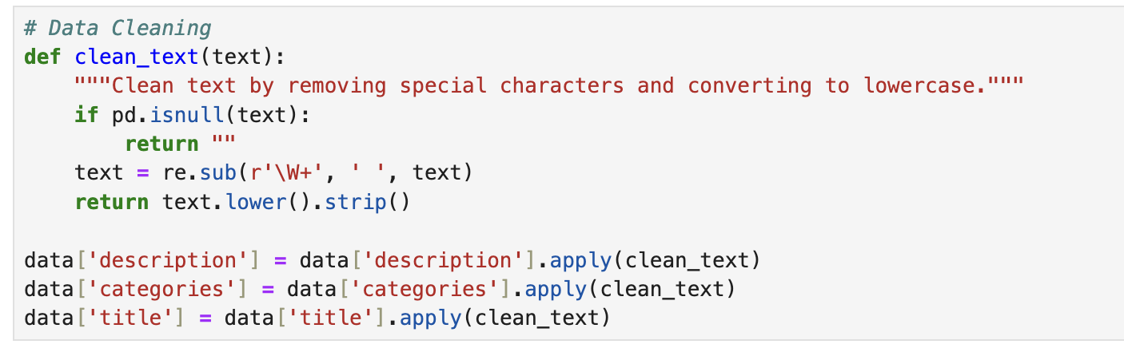
Data Standardization and Cleaning
Imputed Missing Numerical Values
Used the median to fill gaps in:
average_rating
num_pages
ratings_count Text Cleaning & Feature Engineering Cleaned Text Columns
Applied cleaning steps to description, categories, and title:
Removed special characters using regex (\W+).
Converted text to lowercase.
Stripped whitespace for uniformity. Created a Combined Features Column
Merged title, description, and categories into a single column combined_features for model input.

Slide 11
Data Standardization and Cleaning
Tools and Models
SpellChecker
Corrected misspellings in text columns to improve data quality.
SentenceTransformer (BERT)
Used all-MiniLM-L6-v2 to generate embeddings for combined_features.
Enabled clustering and similarity-based recommendations.
Emotion Analysis
Leveraged j-hartmann/emotion-english-distilroberta-base to classify emotional tone in book descriptions and reviews.

Slide 12
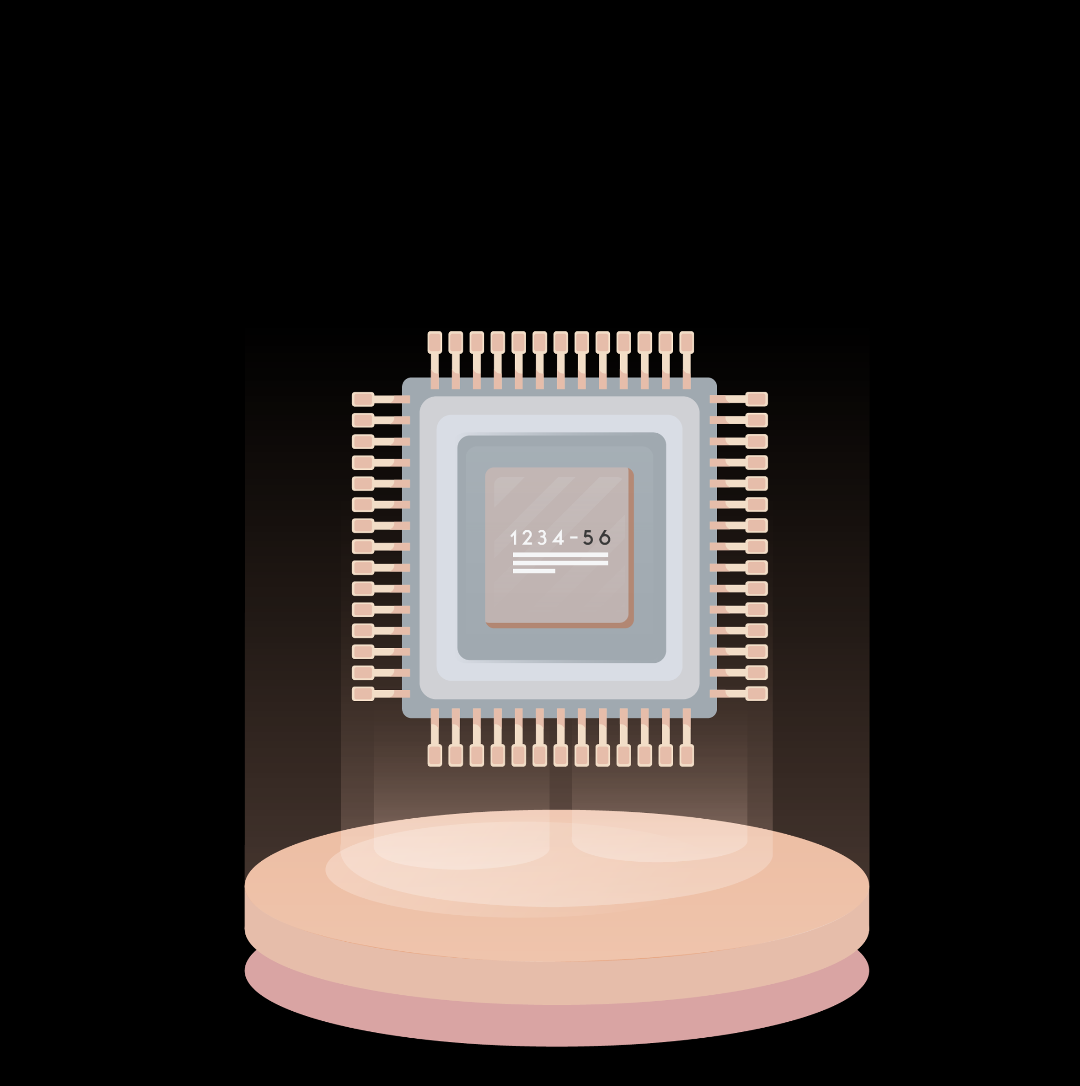
Modeling

Slide 13
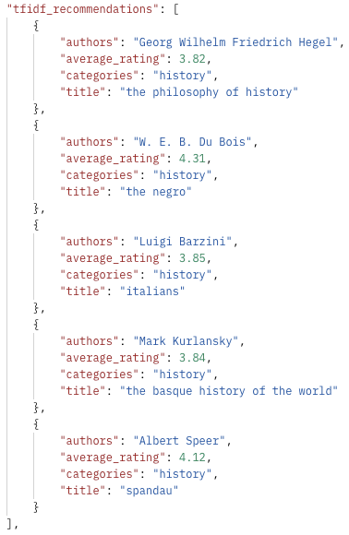
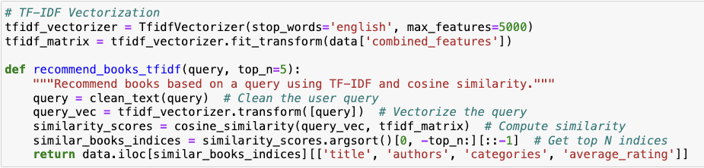
TF-IDF-Based Content Filtering
Methodology: Uses the TF-IDF vectorizer to represent book descriptions as
numerical vectors.
Calculates cosine similarity between the query vector and book vectors.
Logic: Matches the user's query with book descriptions using a term frequency-inverse
document frequency matrix.
Key Feature: Highlights books closely related to the frequency of the query term
in the text.
What the Code Does:
Vectorizes the book descriptions and user query using TfidfVectorizer.
Computes similarity scores and ranks books based on these scores.
Recommends books that closely match the query's content.
Flask API: Postman output
Notes:
Explanation: "TF-IDF focuses on term frequency and relevance in the query and book descriptions. It’s great for matching exact or frequent terms in the dataset."
Output Overlay:
"TF-IDF returned books like 'The Philosophy of History' and 'The Negro.' These have high term overlap with 'history.' Notice it sticks closely to books explicitly categorized as history.
So user queries lack precise keywords - so basic models like TF IDF find it difficult to give relevant reccos, and hence the dashboard you found to be a good solution - by allowing users to ask specific topics
Advanced models like Roberta and BERT are computationally very intense, so used caching to optimise response times
Different models give outputs in different formats - so we needed to convert everything to JSON for seamless integration with Flask API and Postman
The Flask API acts as a backend service for the book recommendation system. It takes user queries, processes them, and uses pre-trained models like TF-IDF, BERT, and Hybrid to generate book recommendations. The results are returned in a structured JSON format, making it easy for tools like Postman or frontend applications (e.g., Streamlit) to display them.

Slide 14
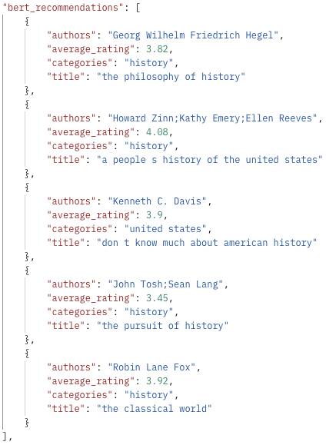
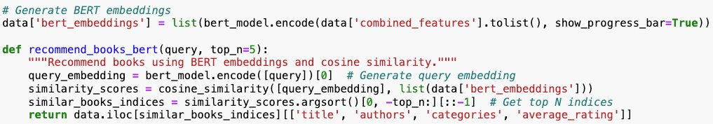
BERT-Based Recommendation
Methodology: Leverages BERT embeddings to represent book descriptions semantically.
Matches user queries to book descriptions based on cosine similarity in the embedding space.
Logic: Embeddings-based semantic similarity between the query and book descriptions using
the BERT model.
Key Feature: Captures deeper contextual meanings of the query.
What the Code Does:
Generates embeddings for book descriptions and the user query using a pre-trained BERT model.
Computes similarity scores and retrieves the most relevant books.
Offers deeper semantic understanding compared to TF-IDF.
Flask API: Postman output
Notes:
Explanation: "BERT understands the semantic context of the query and book descriptions. It excels at finding relevant matches even when exact terms aren’t present."
Output Overlay:
"BERT recommended 'A People’s History of the United States' and 'The Classical World,' which are historically rich but also semantically aligned with broader themes like U.S. and ancient history."

Slide 15
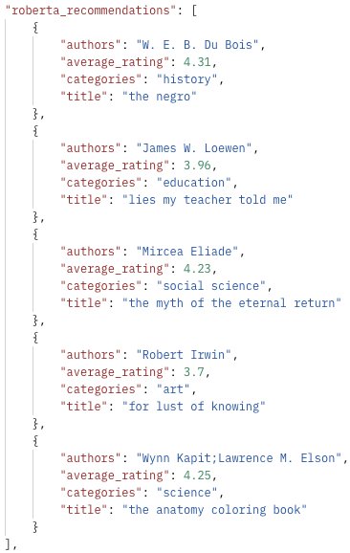
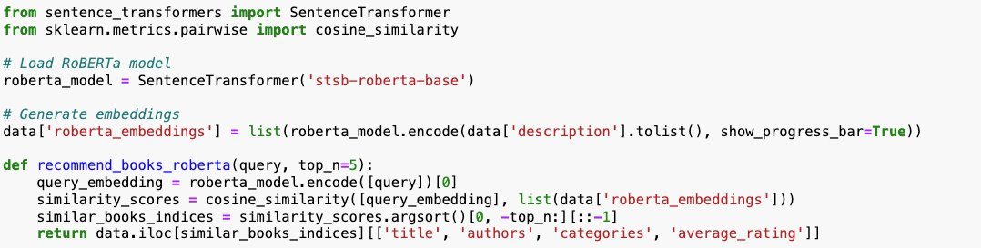
RoBERTa-Based Recommendation
Methodology: Similar to BERT but utilizes the RoBERTa model for improved pre-training and performance.
Captures nuanced contextual meanings in book descriptions.
Logic: Similar to BERT but uses a more robust fine-tuned transformer model.
Key Feature: Often provides contextually nuanced recommendations.
What the Code Does:
Processes book descriptions and user queries through RoBERTa to generate embeddings.
Measures cosine similarity to provide recommendations.
Focuses on high-quality contextual representations.
Flask API: Postman output
Notes:
Explanation: "RoBERTa builds on BERT, refining contextual understanding by leveraging enhanced training techniques. This often leads to deeper semantic matches."
Output Overlay:
"Recommendations like 'The Negro' and 'Lies My Teacher Told Me' showcase how RoBERTa connects 'history' to educational and social contexts."

Slide 16
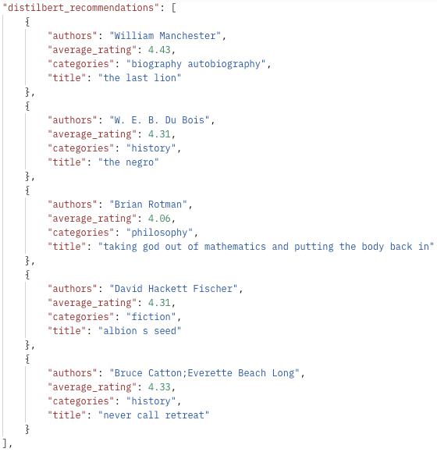
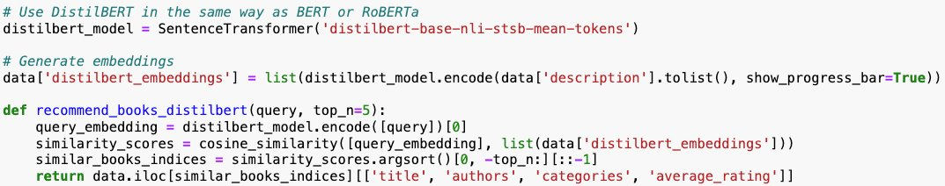
DistilBERT-Based Recommendation
Methodology:
A distilled version of BERT offering a faster and lighter alternative with minimal loss
in accuracy.
Ideal for resource-constrained environments.
Logic: A lightweight version of BERT for faster results.
Key Feature: Trades off some accuracy for speed.
What the Code Does:
Computes embeddings for descriptions and queries using DistilBERT.
Identifies the most similar books using cosine similarity.
Balances efficiency and effectiveness in recommendations.
Flask API: Postman output
Notes:
Explanation: "DistilBERT, while lightweight, maintains much of BERT’s understanding, making it a faster, more efficient choice for real-time recommendations."
Output Overlay:
"Books like 'The Last Lion' and 'Never Call Retreat' reflect its ability to focus on biographical and historical narratives while being computationally efficient."

Slide 17
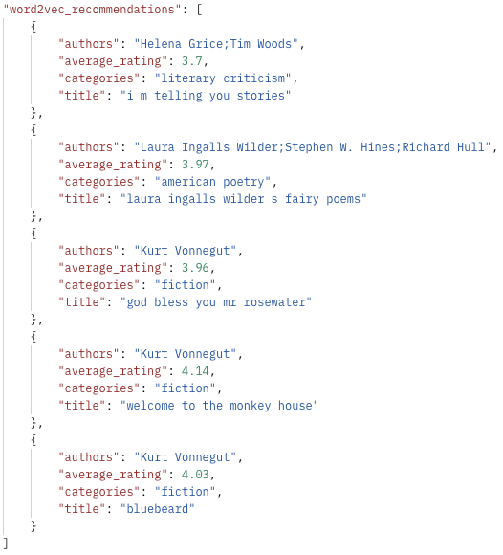
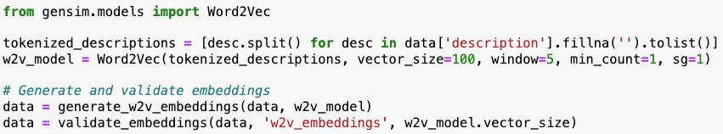
Word2Vec-Based Recommendation
Methodology:
Represents words as dense vectors capturing semantic similarity through training
on a corpus.
Averages word vectors to represent entire book descriptions.
Logic: Uses dense vector representations of words to find semantic similarities.
Key Feature: Focuses on word-level embeddings to surface relevant books.
What the Code Does:
Generates word embeddings using Word2Vec for descriptions and user queries.
Aggregates word embeddings to form book and query vectors.
Matches books based on cosine similarity.
Flask API: Postman output
Notes:
Explanation: "Word2Vec captures thematic similarities based on word embeddings. It focuses on relationships between words in the dataset."
Output Overlay:
"It suggests 'I’m Telling You Stories' and 'God Bless You, Mr. Rosewater.' While these aren’t explicitly historical, their underlying themes connect to storytelling and cultural history."

Slide 18
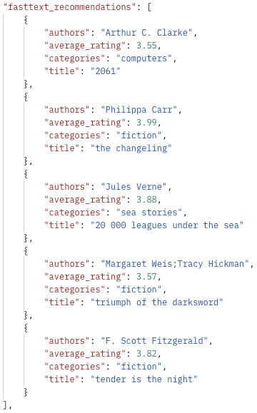
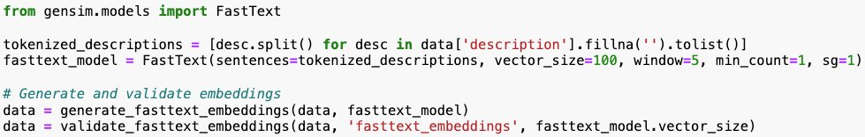
FastText-Based Recommendation
Methodology:
Enhances Word2Vec by considering subword information (character n-grams).
Better for handling out-of-vocabulary words.
Logic: Similar to Word2Vec but includes subword information for better handling of rare and misspelled words.
Key Feature: Handles morphological richness in queries and data.
What the Code Does:
Uses FastText to create embeddings for book descriptions and queries.
Matches based on similarity scores derived from these embeddings.
Improves robustness in recommendations for uncommon words.
Flask API: Postman output
Notes:
Explanation: "FastText extends Word2Vec by considering subword information, making it robust to rare or misspelled words."
Output Overlay:
"Books like '20,000 Leagues Under the Sea' and 'Tender is the Night' highlight FastText’s ability to infer thematic connections, even when direct matches aren’t obvious."

Slide 19
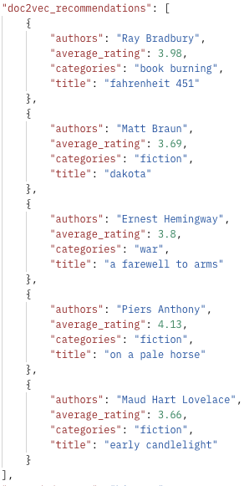
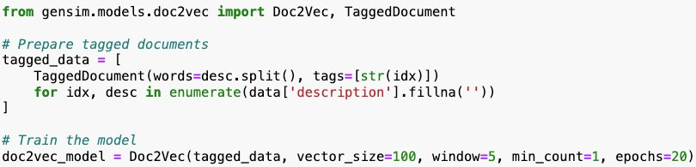
Doc2Vec-Based Recommendation
Methodology:
Extends Word2Vec to represent entire documents (e.g., book descriptions) as vectors.
Captures the holistic context of a document.
Logic: Extends Word2Vec to work with entire documents instead of individual words.
Key Feature: Captures document-level semantics.
What the Code Does:
Trains Doc2Vec on book descriptions to learn document-level embeddings.
Computes similarity between the query and book vectors.
Provides content-aware recommendations based on document similarity.
Flask API: Postman output
Notes:
Explanation: "Doc2Vec generates embeddings for entire documents, offering recommendations based on overall document similarity."
Output Overlay:
"Results like 'A Farewell to Arms' and 'Early Candlelight' show how Doc2Vec captures broad contextual alignment rather than focusing narrowly on 'history.'"

Slide 20
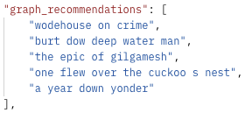
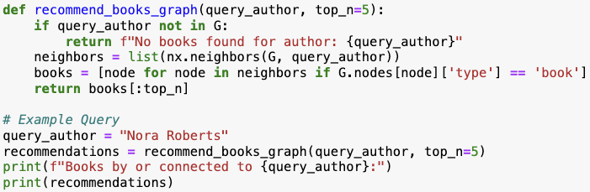
Graph-Based Recommendation
Methodology:
Constructs a graph connecting books to related entities (e.g., authors, genres).
Explores graph relationships to recommend similar books.
Logic: Utilizes author-category relationships to recommend books.
Key Feature: Explores network connections for novel recommendations.
What the Code Does:
Builds a network of books and their attributes.
Traverses the graph using user input (e.g., author name) to find related books.
Exploits structural relationships for recommendations.
Flask API: Postman output
Notes:
Explanation: "Graph-based methods leverage relationships between entities like authors, genres, and categories. They offer recommendations by navigating these connections."
Output Overlay:
"Books such as 'Wodehouse on Crime' and 'The Epic of Gilgamesh' reflect how graph-based models explore tangential yet meaningful connections."

Slide 21
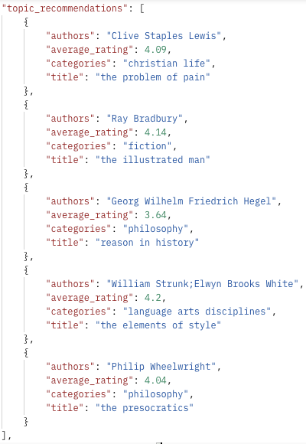
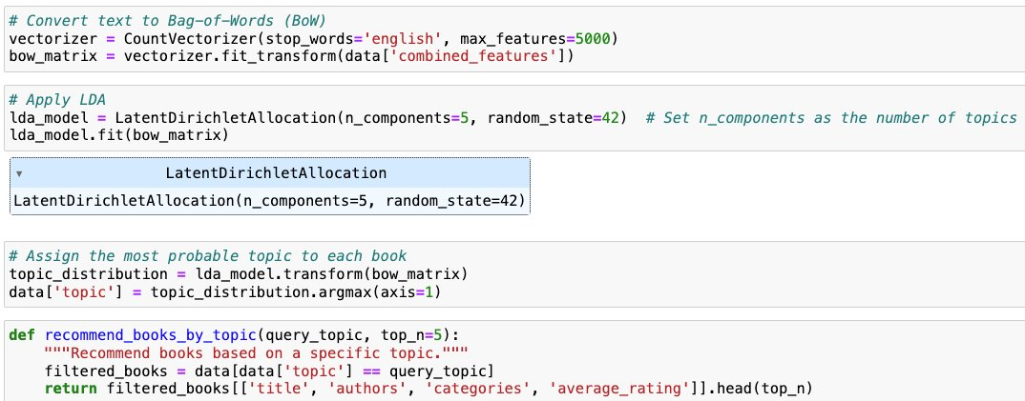
Topic Modeling-Based Recommendation
Methodology:
Uses Latent Dirichlet Allocation (LDA) to extract latent topics from book descriptions.
Matches user queries to these topics for recommendations.
Logic: Maps the query to a topic distribution and finds books with similar topics.
Key Feature: Provides recommendations aligned with the broader thematic structure.
What the Code Does:
Preprocesses book descriptions and applies LDA to generate topic distributions.
Maps user queries to topics and identifies books with similar topic proportions.
Explains recommendations through interpretable topic keywords.
Flask API: Postman output
Notes:
Explanation: "Topic modeling identifies latent themes in the data. It matches user queries to broader themes rather than exact words."
Output Overlay:
"Books like 'Reason in History' and 'The Elements of Style' reveal how this approach interprets 'history' through its philosophical and linguistic dimensions."

Slide 22
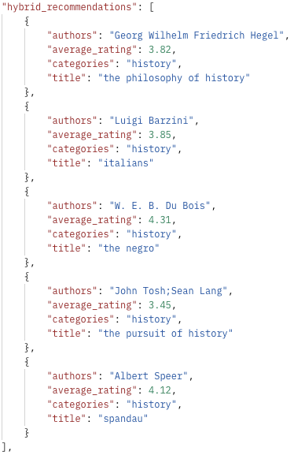
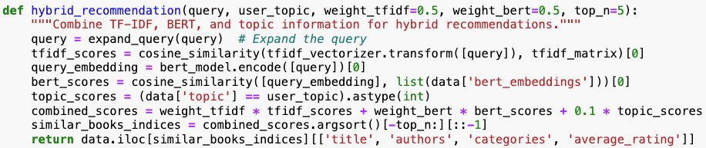
Hybrid Recommendation
Methodology:
Combines multiple models (e.g., content-based, collaborative filtering) to provide balanced
recommendations.
Benefits from the strengths of different models.
Logic: Combines results from multiple models for a comprehensive list.
Key Feature: Balances semantic depth with coverage and diversity.
What the Code Does:
Aggregates outputs from various recommendation models.
Ranks and blends recommendations based on combined similarity scores.
Ensures comprehensive recommendations by integrating diverse perspectives.
Flask API: Postman output
Notes:
Explanation: "The hybrid model combines strengths from all the above approaches, balancing relevance, diversity, and semantic depth."
Output Overlay:
"Recommendations like 'Spandau' and 'The Negro' demonstrate its ability to synthesize semantic understanding, term relevance, and thematic breadth."

Slide 23
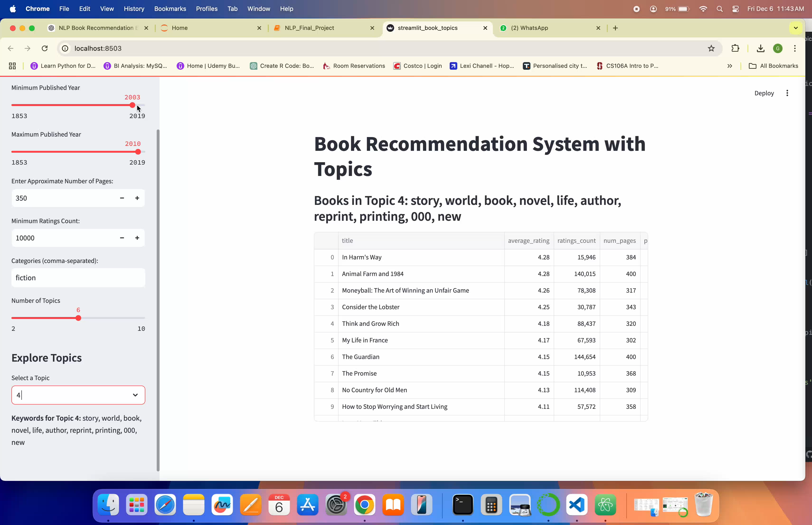
Streamlit Demo

Slide 24
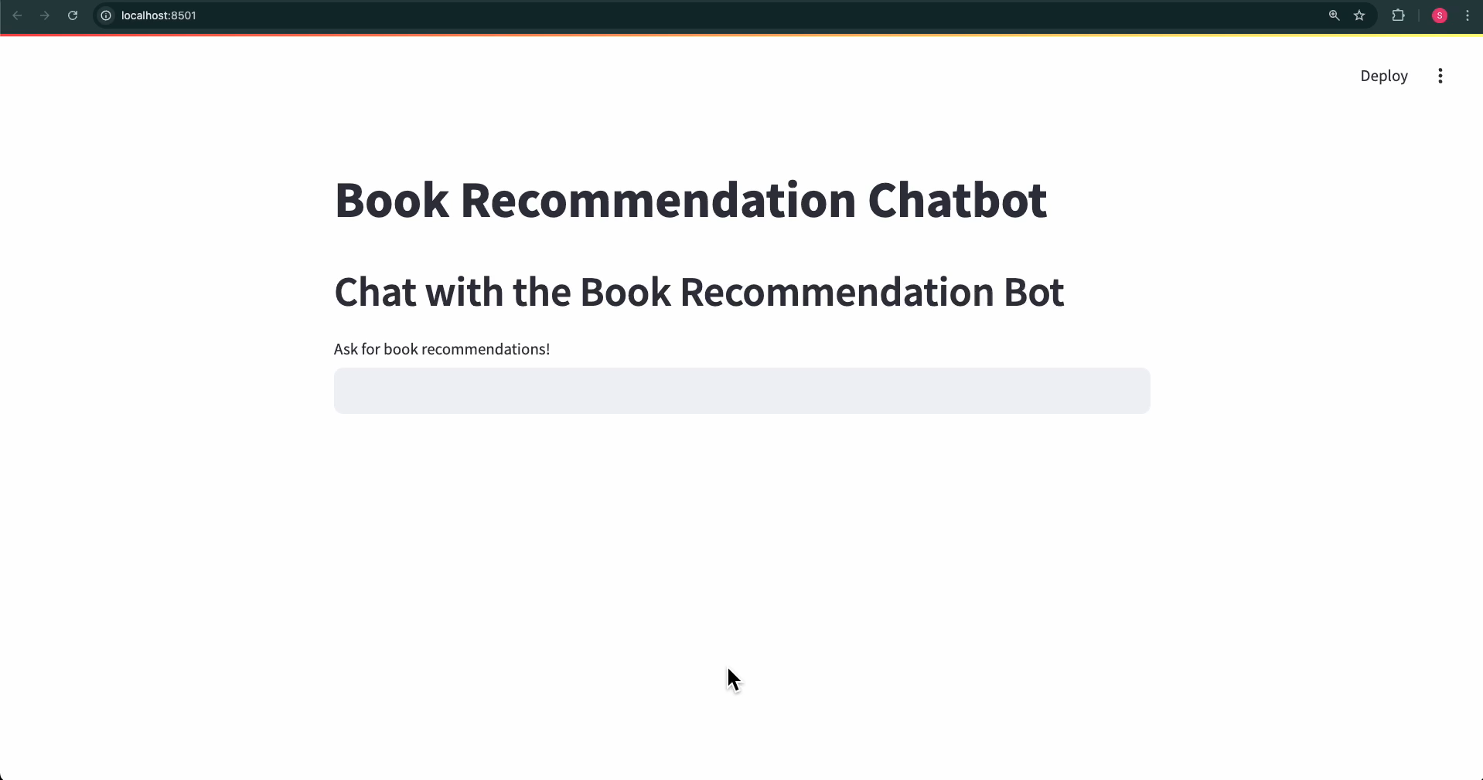
Book Recommendation Chatbot Demo
Notes:
The chatbot has been built to offer a seamless way to explore and connect with a vast array of books."
This chatbot integrates several key components:
Data Loading: The book dataset is preloaded using a caching mechanism in Streamlit to ensure quick and efficient responses.
Recommendation Models: We leverage multiple recommendation techniques, including TF-IDF, BERT, RoBERTa, DistilBERT, and a Hybrid model. Each model adds a unique dimension to the recommendation process:
[can be excluded, since already covered previously]
TF-IDF matches based on term frequency and relevance.
BERT and RoBERTa go beyond keywords to understand the context of user queries.
DistilBERT brings a faster yet accurate semantic matching capability.
Hybrid combines these models for comprehensive and diverse suggestions.
OpenAI API: The chatbot uses OpenAI's GPT-3.5-Turbo model to provide conversational responses. This allows it to interpret queries, explain recommendations, and engage users naturally.
The chatbot operates in three simple steps:
User Input: Users enter a query, such as 'Suggest me books on history.'
Model Integration: The query is processed through the recommendation models, generating lists of book suggestions based on different NLP techniques.
Dynamic Response: The OpenAI API synthesizes the model outputs into a conversational response, explaining why certain books are recommended and engaging users in dialogue.

Slide 25
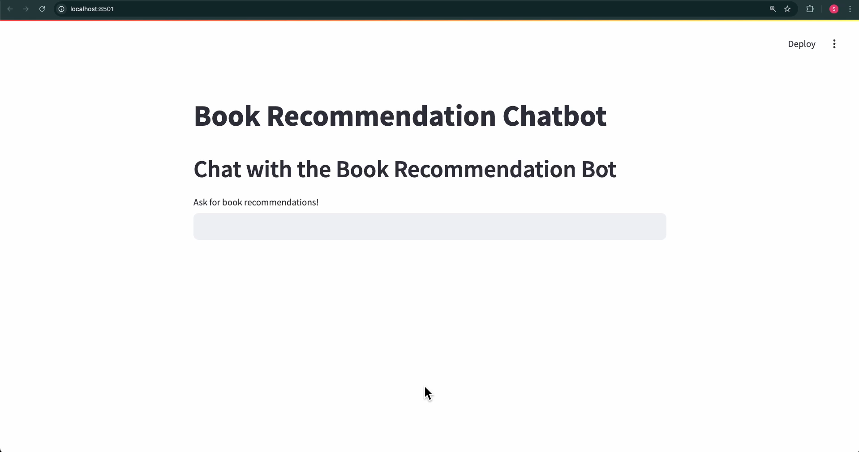
Book Recommendation Chatbot Demo
Notes:
So all 5 models run in the bot
GPT3.5 will then aggregate and give the results
If you ask for a certain year or rating or pages count - GPT 3.5 filters and gives it
You can alternatively filter the data based on user input, and then apply the models, and then use GPT 3.5 for just the conversational part (understanding user queries, intent/semantics, account for misspellings, grammar etc), but that was becoming difficult

Slide 26
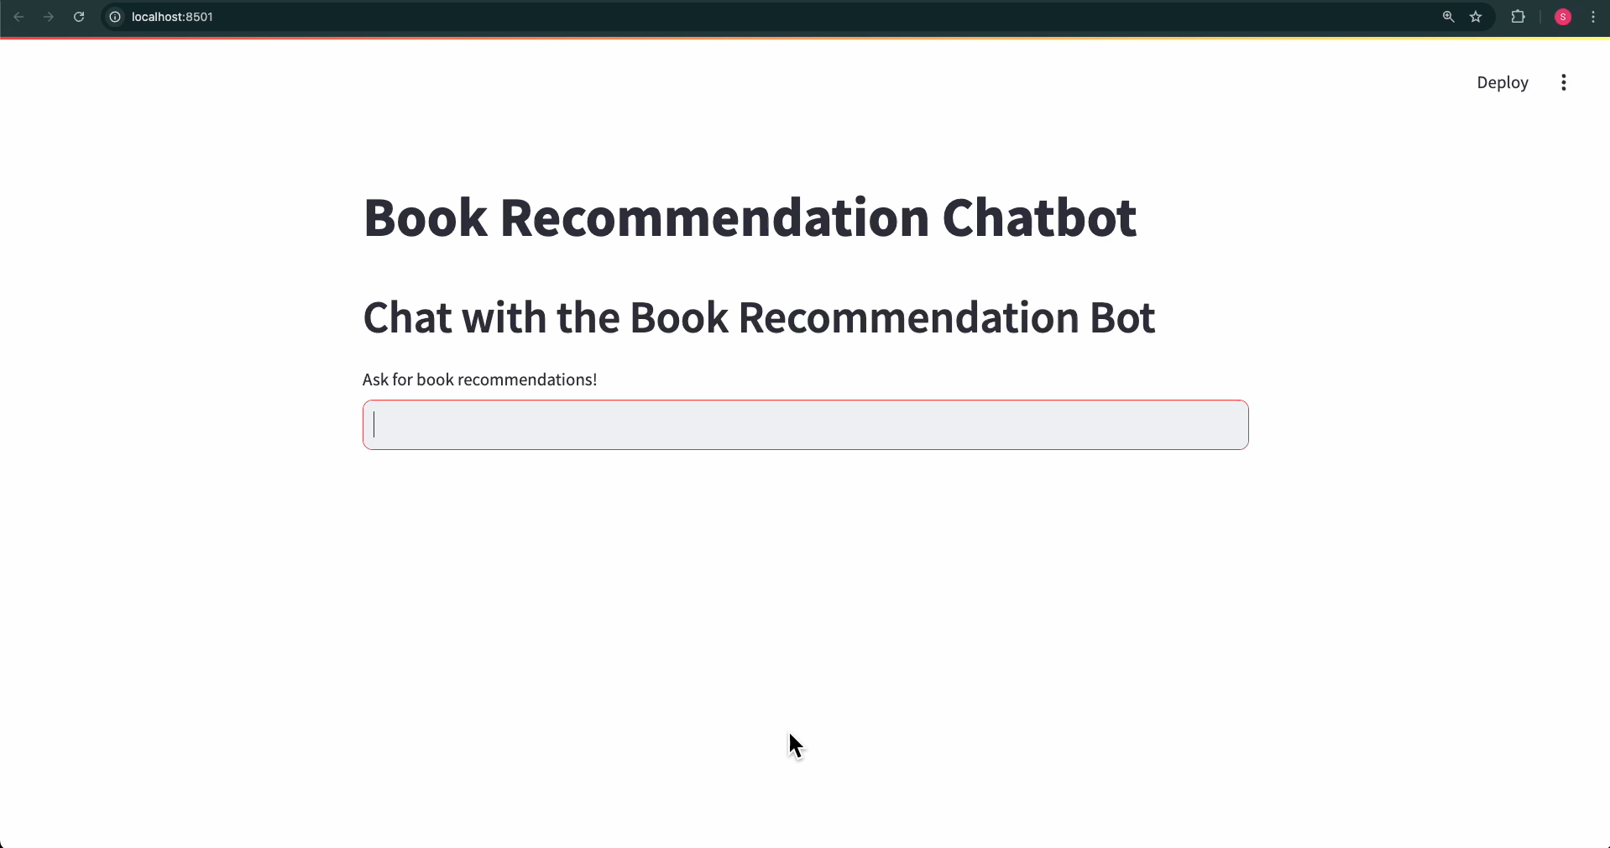
Book Recommendation Chatbot Demo

Slide 27

Book Recommendation Chatbot Demo

Slide 28

Book Recommendation Chatbot Demo

Slide 29

Any questions?

